Slide 1
SIMULATION OF 2D 3STATE POTTS MODEL
By
Angad Singh Gill
ID No. 2005S5P3460
&
C Hanuma Chaitanya
ID No. 2005S5P3755

Slide 2
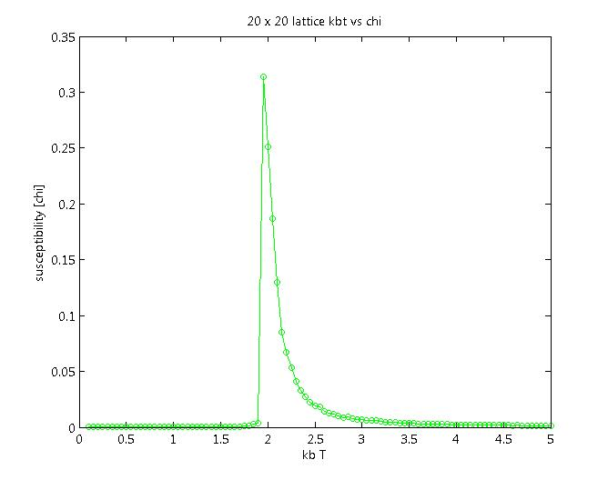
CORRECTIONS IN ISING MODEL SIMULATION
This plot of susceptibility Vs KbT was obtained using the previous code.
Plot is not symmetric.

Slide 3
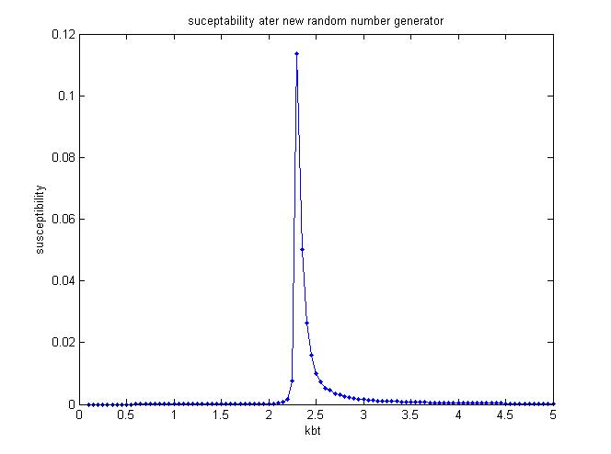
CORRECTIONS IN ISING MODEL SIMULATION
This plot was obtained with the use of a better random number generator.
The plot is symmetric.
The value of KbT for max. susceptibility is closer to the theoretical value

Slide 4
POTTS MODEL
A Potts Model is a generalization of an Ising model.
In the Potts Model the spin variable can take 2 or more states.
This talk is about 2-Dimentional 3-State Potts Model.

Slide 5
2D 3 STATE POTTS MODEL
As in the case 2D Ising Model, a square lattice of size N(number of lattice points) is considered.
Each lattice point corresponds to a spin variable.
The spin variable can take 3 values (unlike in Ising, in which the spin variable can take only 2 values).

Slide 6

2D 3 STATE POTTS MODEL
The Hamiltonian is given by:
The Magnetisation is given by:
Where β=2π/3

Slide 7
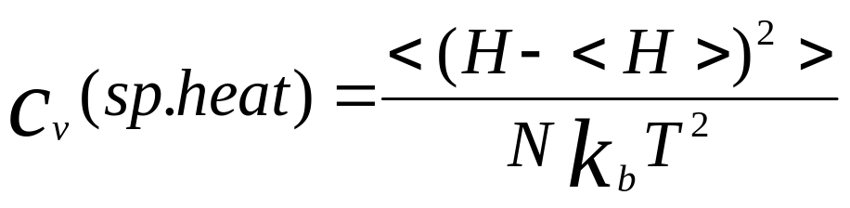
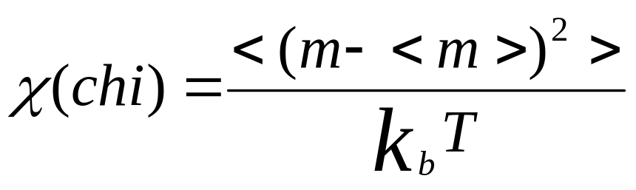
2D 3 STATE POTTS MODEL
The Specific Heat is given by:
The Susceptibility is given by:

Slide 8
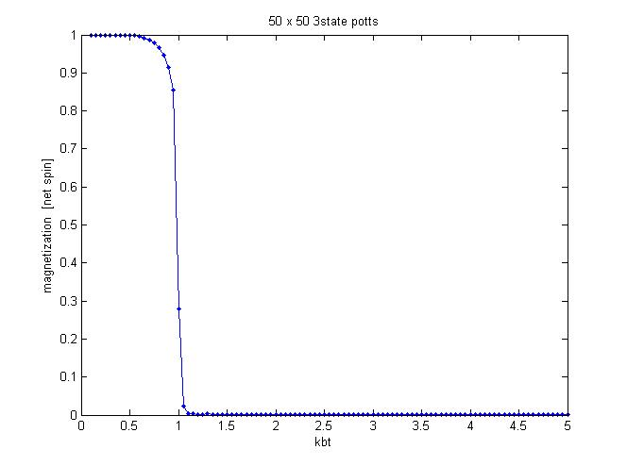
MONTE CARLO SIMULATIONS
Tc ≈ 1

Slide 9
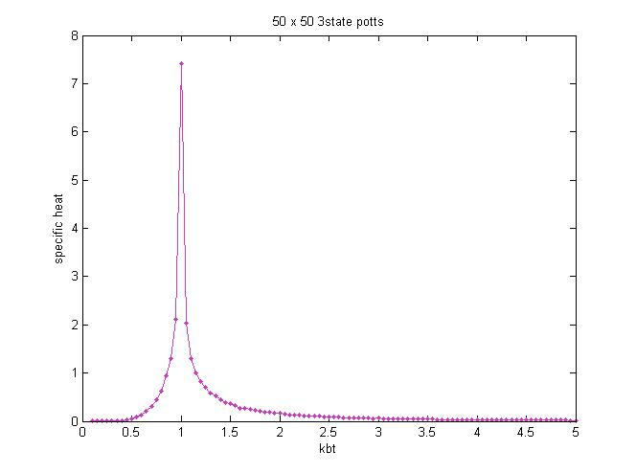
MONTE CARLO SIMULATIONS

Slide 10
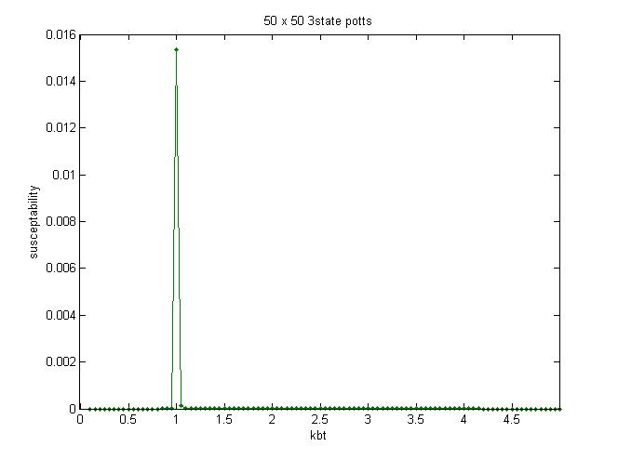
MONTE CARLO SIMULATIONS

Slide 11
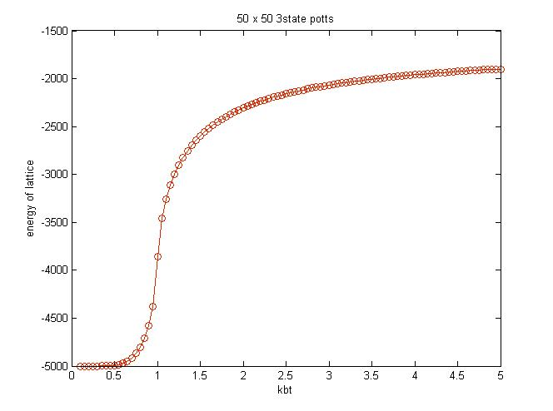
MONTE CARLO SIMULATIONS

